Slide 1
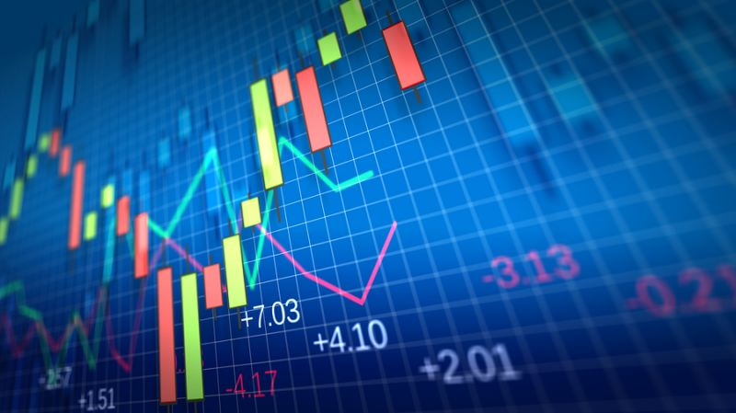
Stock Market prediction using sentiment analysis
Submitted by- Submitted to-
Aryan Vani Mr. Gaurav Thulla

Slide 2
Introduction about topic
People use social networking sites, like Facebook, Twitter, etc. to express their opinions and views about a particular topic such as news, movie, event and remarks related to product. This information available from social network is beneficial for business analyst for mining the user opinion about their products and considers these opinions as feedback to improve their policies, planning and process for product development. Sentiment analysis is used to extract such opinion and remarks of users by classifying them as positive, negative and natural sentiment.

Slide 3
Sentiment analysis
sentiment analysis is a technique used to extract intelligent information based on the person’s opinion from raw data available on the internet.
In this definition, the term opinion means a person’s perspective about an object or issue. There are some challenges related to sentiment analysis, the first challenge is a word that is used to express an opinion; it can be positive as well as negative depending upon the type of sentiment.

Slide 4
Indian stock market
Indian stock market has gained the interest of investors investing in two main stock market named as Bombay Stock Exchange (BSE) and National Stock Exchange (NSE). There is high risk involved for investors because of more complexity of the stock market. The Sensex and NIFTY are two such prominent market indices that function within the Indian stock market.

Slide 5
Sentiment Classification Methodologies
Machine Learning Approach-
Machine learning techniques that are applied in the field of sentiment analysis can be divided as supervised and unsupervised learning method
Supervised Learning-
Decision tree classifier
Rule based classifier
Linear classifier –
Support Vector Machine (SVM)
Neural Network

Slide 6
conclusion
There are various ups and downs in Indian stock market. In order to invest money in stock market for purchasing the shares it is very essential for the investors to predict the stock market condition. In India scenario Sensex and Nifty are two major indicator for prediction of stock market condition. For BSE (Bombay Stock Exchange) companies Sensex and for NSE (National Stock Exchange) companies Nifty is used as an indicator of stock market prediction. But the major problem for the investors are to predict the stock market condition which depends upon regular checking and testing of Sensex and Nifty prediction values. In order to allow this, in this paper we have demonstrated sentiment analysis for stock market by fetching Sensex and Nifty live server data values on different interval of time that can be used for predicting the stock market status. For this purpose we have used python scripting language which have fast execution environment and this will help out the investors in order to make a prediction of on what shares money should be invested, it will also help in maintaining the economical balance of share market. In Future work can be done by running these python script code with more advanced functions.

Slide 7
Github link
https://github.com/aryanvani/stock-market-prediction.git

Slide 8
Thank you

